Slide 1

HYDR’s GitHub
A practical guide
Paul Muñoz
All-hands meeting 2025
24/09/2025

Slide 2


One place for all our code and workflows
Most computational hydrology is not reproducible, so is it really science? (Hutton et al., 2016)
Improves collaboration inside and outside HYDR
Personal vs. HYDR
Own projects, personal website
HYDR: work done within the department
HYDR

Slide 3


Our numbers in GitHub
71 repositories
39 members (>40 % are former)
0 projects (shared planning spaces)
1 team only (Groundwater group )
0 Packages (available, but rarely used so far)

Slide 4
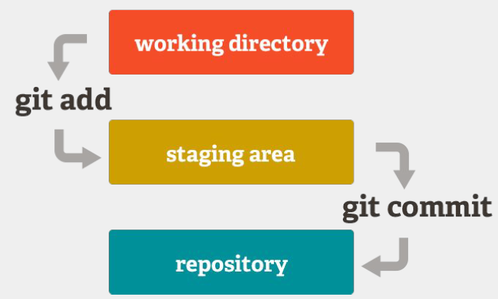
Git & GitHub Basics
Key terminology: repo, commit, branch, fork, pull request
Basic commands
git clone {repo url}
git add {filename}
git commit -m “comments”
git push
git pull
git status
Undoing mistakes (reset, revert, checkout)

Slide 5
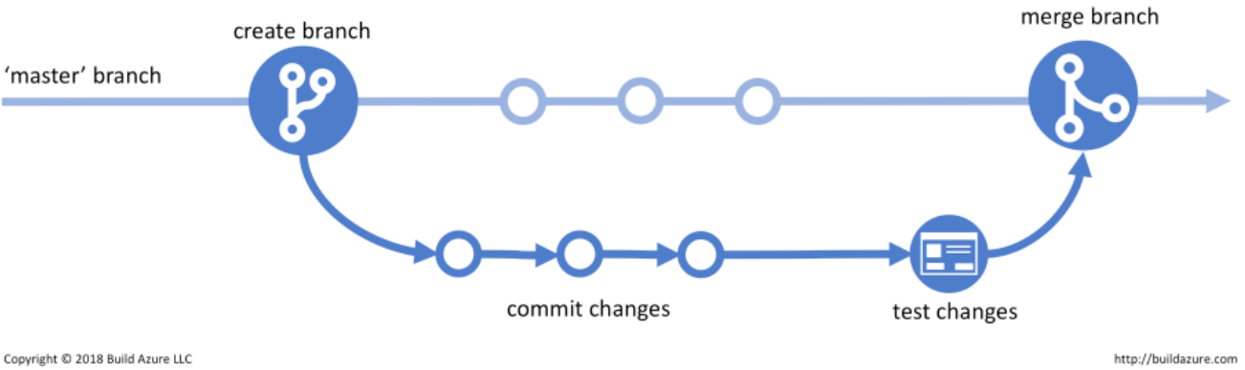
Git & GitHub Basics

Slide 6
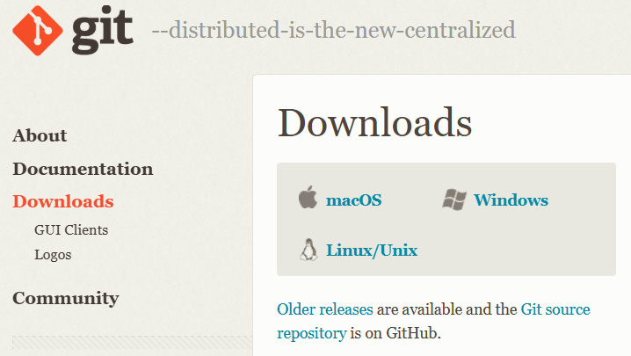

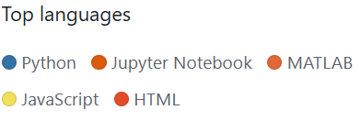
Getting started
1. Installing Git in your machine
2. Setting up a GitHub account & ‘joining’ HYDR

Slide 7
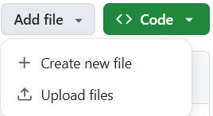
Getting started
Three ways to interact with GitHub:
1. Create/upload files online
(limited use, not recommended)
2. GitHub Desktop
3. Git command line (powerful, flexible, for advanced workflows)

Slide 8

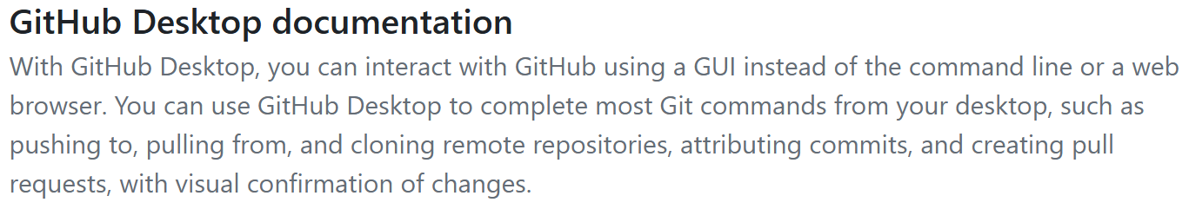
GitHub desktop
Download

Slide 9



HYDR conventions
Classes of repositories (not official GitHub categories):
Software → models, big codes
Tools → scripts, pre/post-processors
Publications → code used in papers
Vignettes → tutorials, workflows, documentation
Presentations → slides, seminar material
Add class as repo topic →example
Notes:
No folder organisation for repos

Slide 10
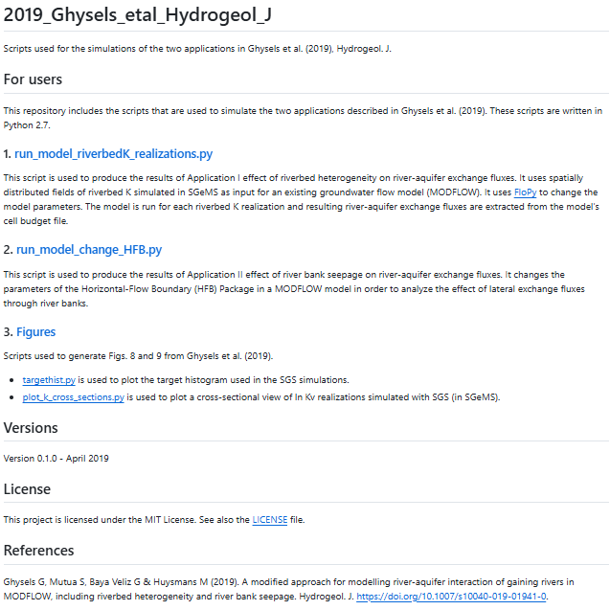
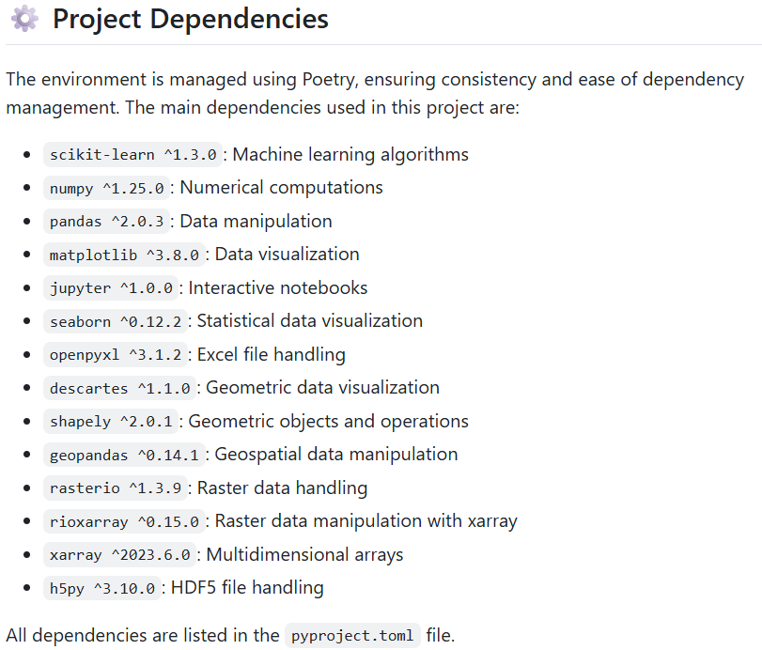
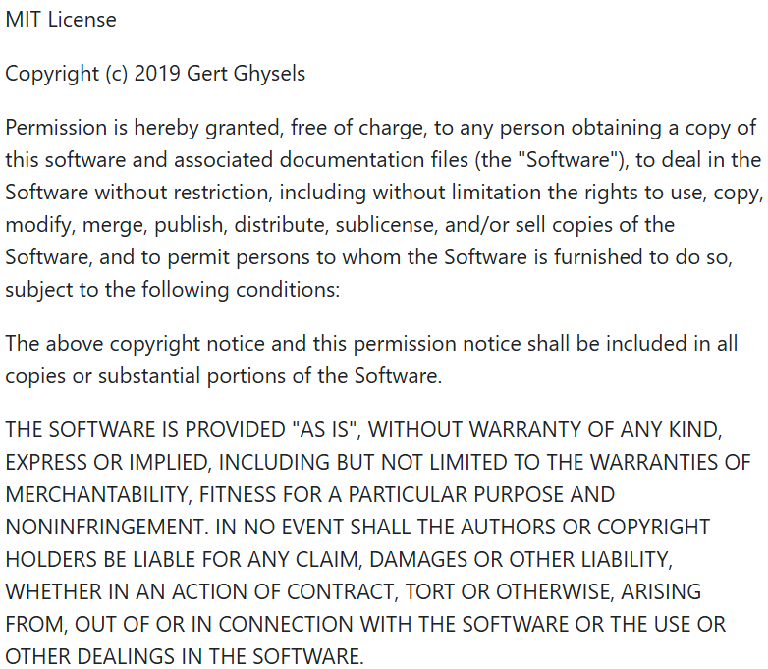
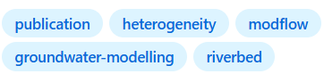
HYDR conventions
Naming conventions for repos
Publications: YYYY_LASTNAME_JOURNAL_SUFFIX
Publication: Ghysels G, Mutua S, Baya Veliz G & Huysmans M (2019). A modified approach for modelling river-aquifer interaction of gaining rivers in MODFLOW, including riverbed heterogeneity and river bank seepage. Hydrogeol.
Metadata requirements:
written in the Markdown “.md” language
SESSIONINFO (mandatory for publications)
README (mandatory)
LICENSE (mandatory)
Optional:
.gitignorem, AUTHORS, CONTRIBUTING, etc.
Repo name: 2019_Ghysels_etal_Hydrogeol_J
Description: Scripts used for the simulations of the two applications in Ghysels et al. (2019), Hydrogeol. J.
Topic: Publication

Slide 11
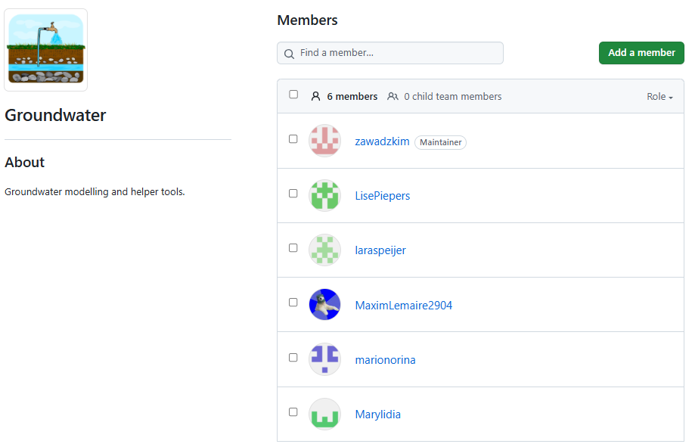
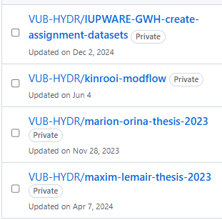
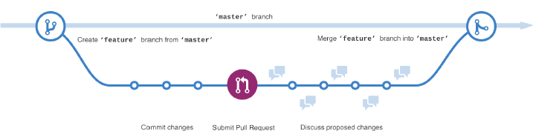
Ways to collaborate
Internal (HYDR) and external collaborators (managed by HYDR owners)
Use a ‘Team’ when multiple people committing to one or more repos (managed by Team owner)
Read-only, cloning, pushing
Source: GitHub
All changes are made in a separate branch. Members never push directly to the main branch.

Slide 12
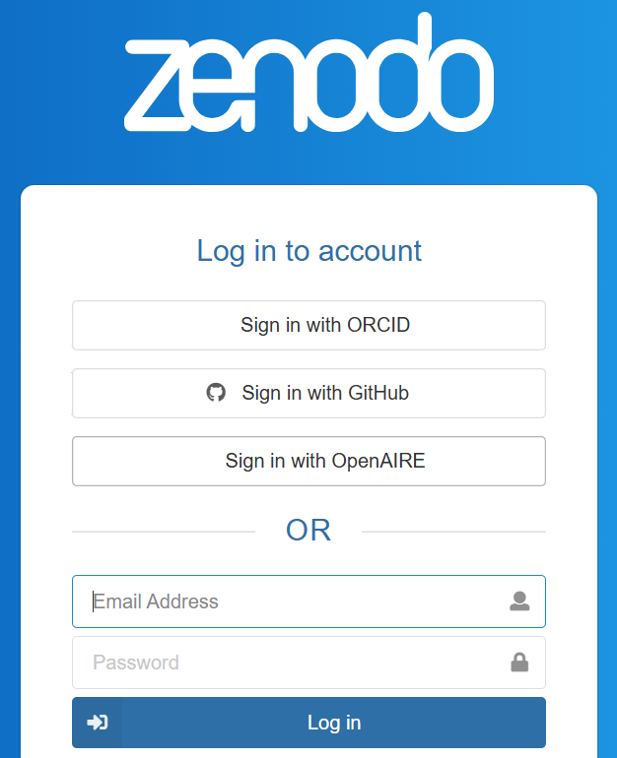
Adding a DOI to your repository
A Digital Object Indicator doesn’t get broken
Different code versions with different DOIs
Adding a DOI via Zenodo (https://zenodo.org/)
Steps:
Prepare your repo → README, LICENSE, Create a release (tag version, publish)
Connect GitHub → Zenodo
Add DOI badge in README

Slide 13
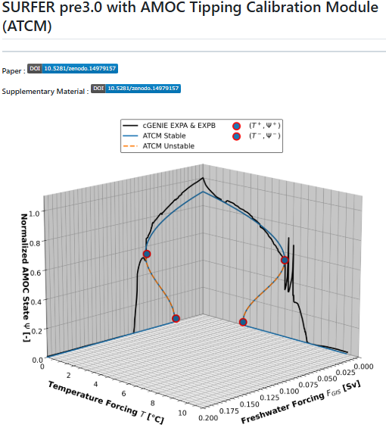
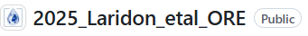
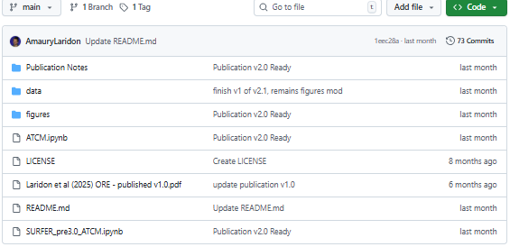
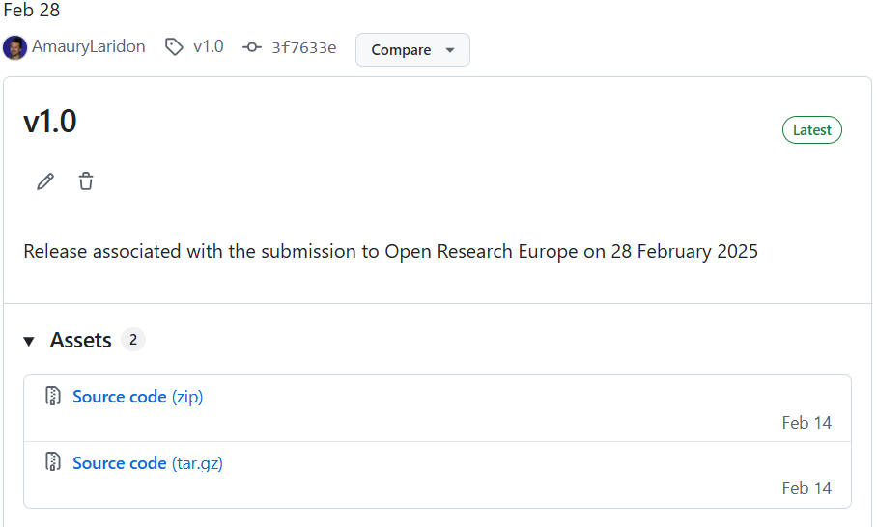
A good example

Slide 14
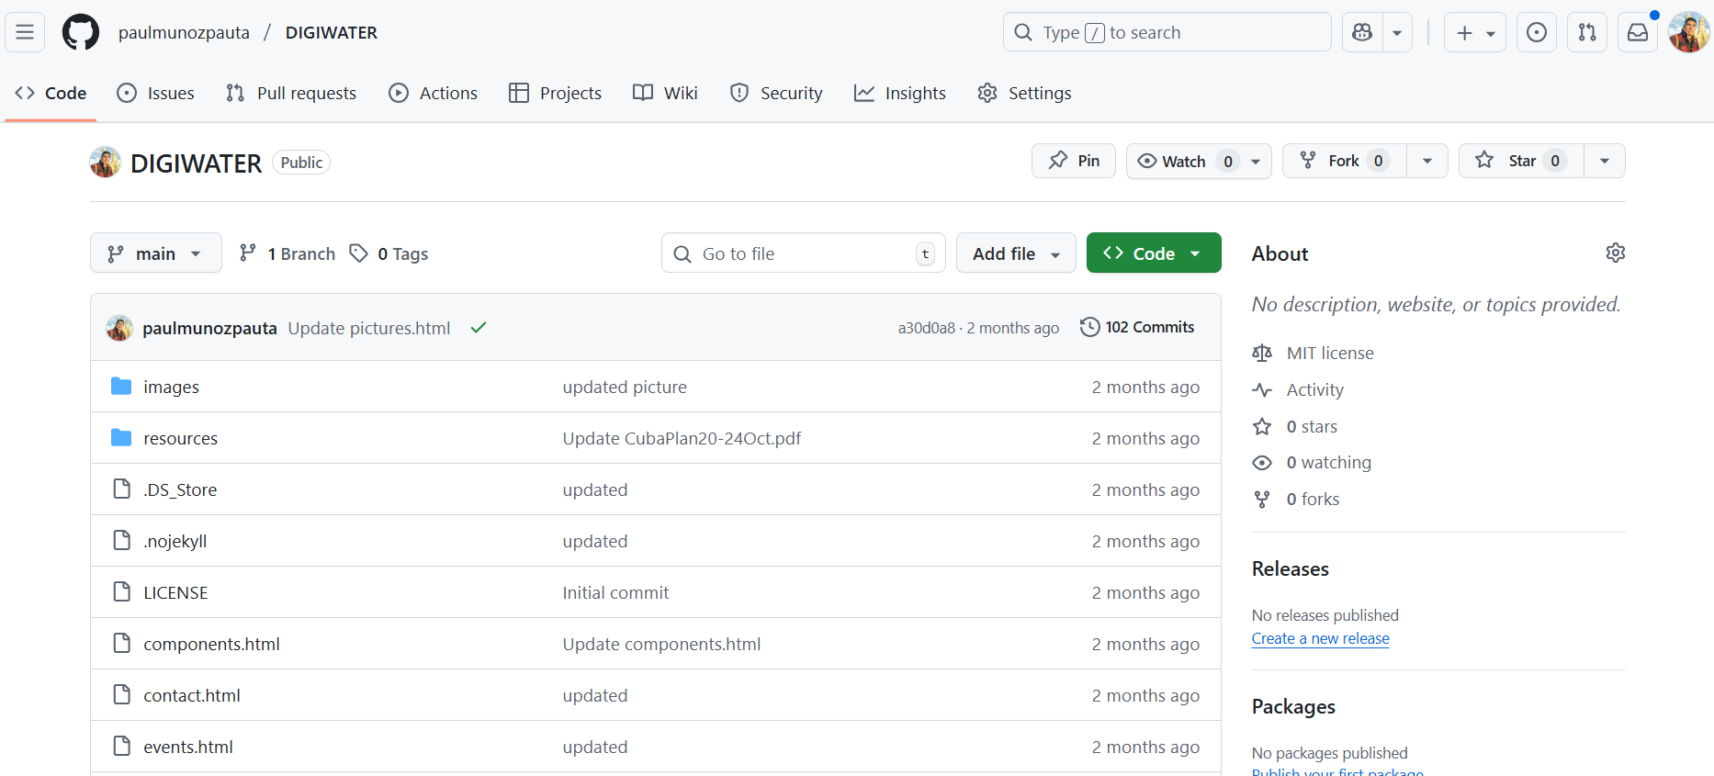
GitHub hosts pages for free
GitHub repository for a Project
Page associated to a project repo
Optional: buy a domain only, server not needed (https://digiwater.net/)
pulling from repo

Slide 15
Other advanced features
GitHub actions → automate tasks (e.g., testing, building, or deploying)
Turning code into packages (R, Python)
Projects & Kanban boards → organize tasks and milestones
Issues & Pull requests → structured way to report bugs, suggest features, code review
Wikis & pages → host documentation, guides, or even project websites
...

Slide 16
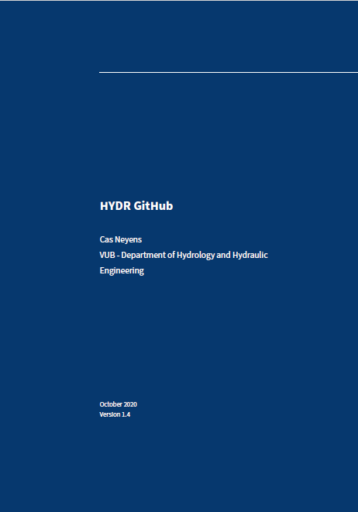
Next steps
Afnan
Amaury
Derrick
Ni
Paul
Talk to your group leader and admin
Special licence for repo?
Add external collaborators
Strongly recommended to have teams either by projects/research groups.
Populate HYDRWiki with general/practical information
Check the GitHub guide
Docjobs 2025

